Slide 1

AtliQ Hardware
Sales Analytics Report
By: Pratosh Kumar Jha

Slide 2
AtliQ Hardware
AtliQ Hardware is a leading provider of computer hardware components including CPUs, RAMs, mouse, and other essential PC and laptop parts. With a strong customer base comprising renowned retailers such as CROMA, Best Buy, Staples, and Flipkart, AtliQ operates through a dual-channel model to serve a wide range of end consumers.
Customers are categorized into two primary segments:
Brick & Mortar (Retail) – Physical stores like CROMA and Vijay Sales.
E-commerce – Online platforms including Amazon, Flipkart, and Snapdeal.
In addition to serving these channels, AtliQ also engages in direct-to-consumer sales through its exclusive outlets – AtliQ Exclusive stores and the AtliQ Hardware e-store, offering greater control over branding, pricing, and customer experience.
Based on the stakeholder's requirements, the following insights have been generated by analyzing the data in response to the questions shared:
By: Pratosh Kumar Jha

Slide 3
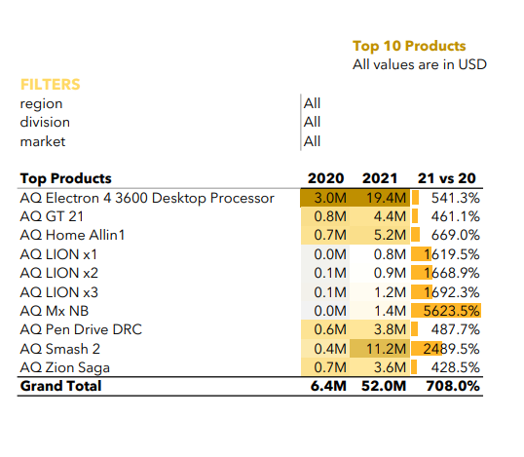
AtliQ Hardware
Q: What are the top 10 products based on the percentage increase in their net sales from 2020 to 2021?
By: Pratosh Kumar Jha

Slide 4
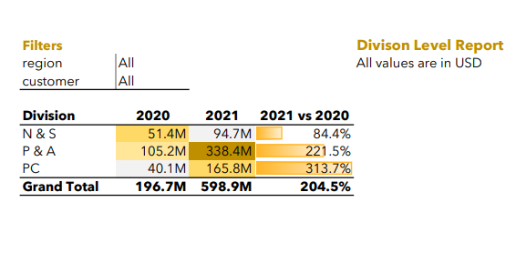
AtliQ Hardware
Q: Generate a "Division" report to present the net sales data for 2020 and 2021, along with the growth percentage.
By: Pratosh Kumar Jha

Slide 5
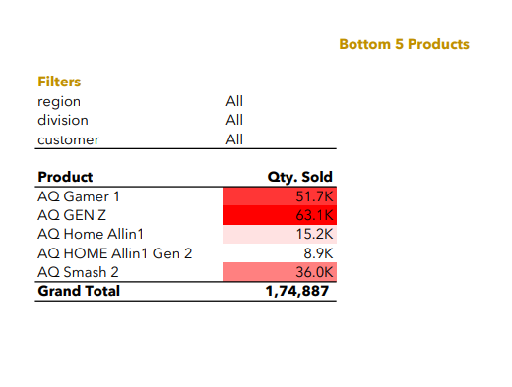
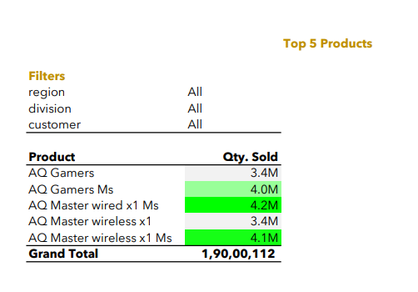
AtliQ Hardware
Q: Which products are ranked in the top 5 and bottom 5 in terms of quantity sold?
By: Pratosh Kumar Jha

Slide 6
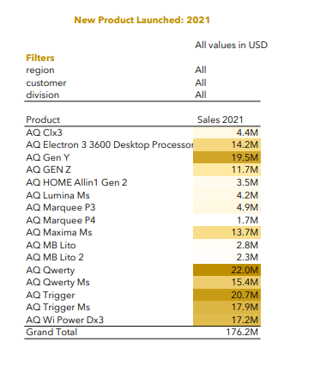
AtliQ Hardware
Q: What are the new products that Atliq began selling in 2021
By: Pratosh Kumar Jha

Slide 7
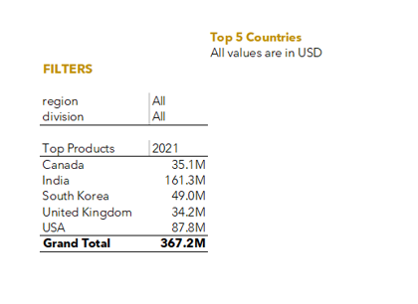
AtliQ Hardware
Q: What are the top 5 countries in terms of net sales in 2021?
By: Pratosh Kumar Jha

